Slide 1

COMP6115 Object Oriented Analysis and Design

Slide 2
INTRODUCTION

Slide 3







Introduction
Rhio Sutoyo S.Kom., M.Sc. Kode Dosen: D4740 📧 rsutoyo@binus.ac.id
Teaching Information Lecturer at Computer Science Department Bina Nusantara University
Work Position Data Analytics & Business Process Manager
President’s Office, BINUS University
Education Background
Bachelor
Master

Slide 4
Introduction to Object Oriented System Analysis and Design
Course Object Oriented System Analysis and Design includes the advanced concepts of software development approach using design visual tool Unified Modelling Language.
This course will be the foundation and prerequisite for computer science faculty student who specifies in software engineering subject.

Slide 5
Learning Outcome
LO1 Conceive the basics concepts of object oriented analysis and design.
LO2 Use the knowledge to develop documentation for object oriented software analysis and design using Unified Modelling Language
LO3 Analyze any problem in any software application and find out the alternative solutions using object oriented analysis and design approach
LO4 Manage the software process and build software development teams based on object oriented analysis and design approach

Slide 6
ESSENTIAL INFORMATION

Slide 7
Evaluation Weight
CLASS_TYPE | COMPONENT | WEIGHT
THEORY | Assignment | 10%
THEORY | Mid Exam | 20%
THEORY | Final Exam | 30%
LAB | Assignment | 12%
LAB | Project | 18%
THEORY | Case Study | 10%
Note: Kelas Praktikum diselenggarakan secara online

Slide 8

Textbooks
Alan Dennis, Barbara Haley Wixom. (2015). Systems Analysisi & Design, An Object-Oriented Approach with UML. 5. John Wiley & Sons. Hoboken, New Jersey. ISBN: 9781118804674.

Slide 9
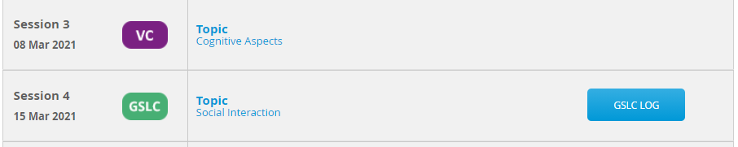
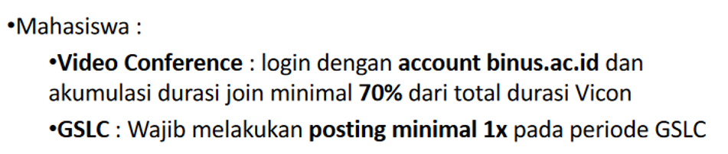
Learning Activities & Attendances
IMPORTANT NOTE FAILED TO MEET CERTAIN NUMBER OF ATTENDANCE WILL CAUSE YOU CANNOT JOIN THE EXAMS

Slide 10
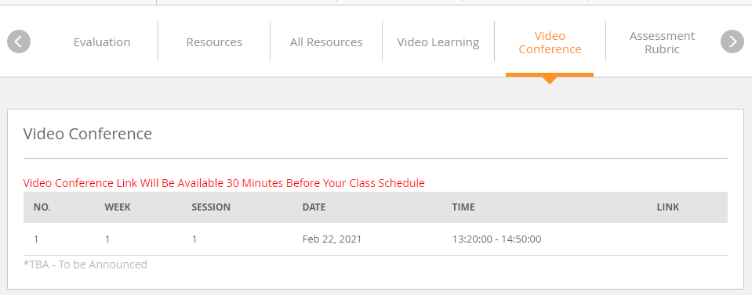
Download Recorded Video Conference (VC)

Slide 11
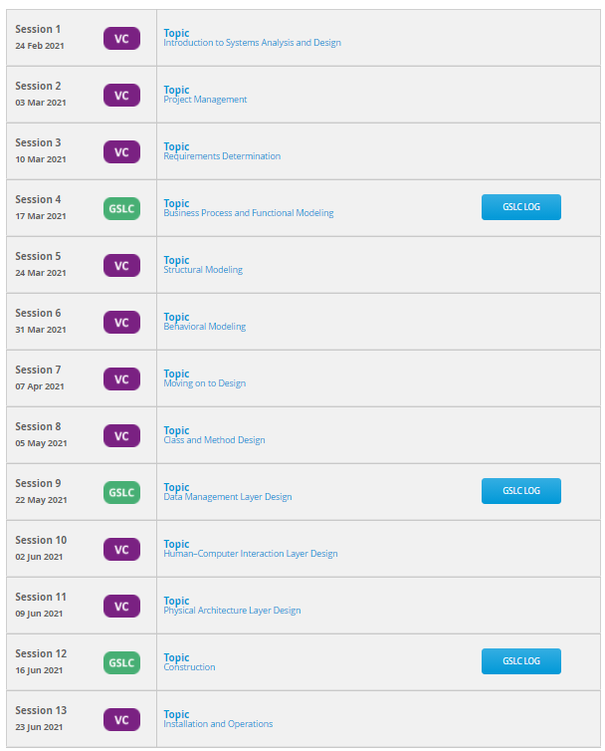

Slide 12
COMP6115 Object Oriented Analysis and Design Session #1

Slide 13
Introduction to Object Databases

Slide 14
Learning Outcomes
LO1:
Identify the basic concept of advance topic in Object Oriented Analysis and Design

Slide 15
Chapter 1: Introduction to Systems Analysis and Design

Slide 16
Learning Objectives
Systems development life cycle
Identify the four phases
How it came about
Methodology alternatives
Team roles & skill sets
Object-oriented systems characteristics
Object-oriented systems analysis & design
The Unified Process & its extensions
The Unified Modeling Language (UML)

Slide 17
Introduction
Why do we need a formal process?
Failures occur (too) often
Creating systems is not intuitive
Projects are late, over budget or delivered with fewer features than planned
The System Analyst is the key person
Designs a system to add value
Must understand the business processes
Job is rewarding, yet challenging
Requires specific skill sets

Slide 18
Systems Development Life Cycle (SDLC)
Planning
Analysis
Design
Implementation

Slide 19
The SDLC Process
The process consists of four phases
Each phase consists of a series of steps
Each phase is documented (deliverables)
Phases are executed sequentially, incrementally, iteratively or in some other pattern

Slide 20
Questions to be Answered
Planning phase
Why should we build this system?
What value does it provide?
How long will it take to build?
Analysis phase
Who will use it?
What should the system do for us?
Where & when will it be used?
Design phase
How should we build it?

Slide 21
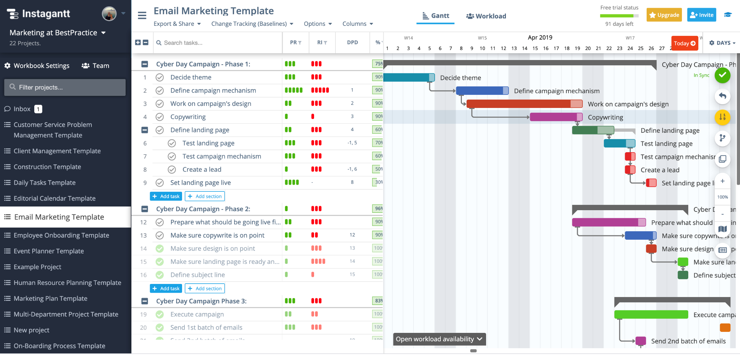
Planning phase
Why should we build this system?
What value does it provide?
How long will it take to build?

Slide 22
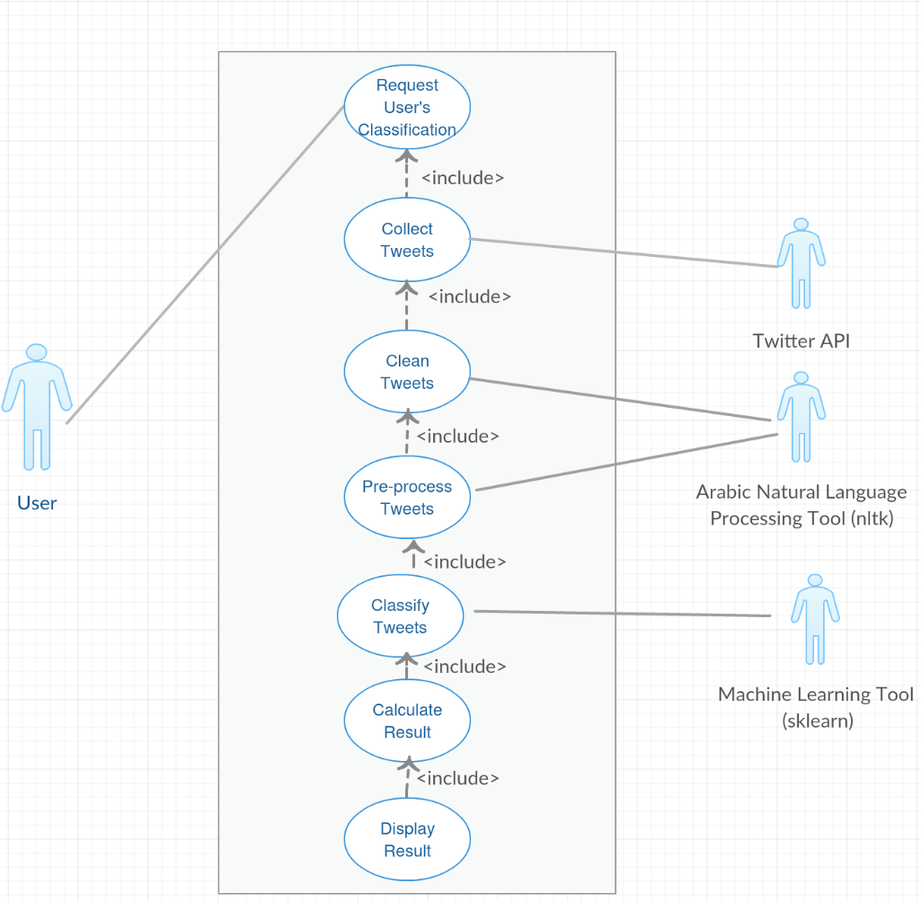
Analysis phase
Who will use it?
What should the system do for us?
Where & when will it be used?
USE CASE

Slide 23
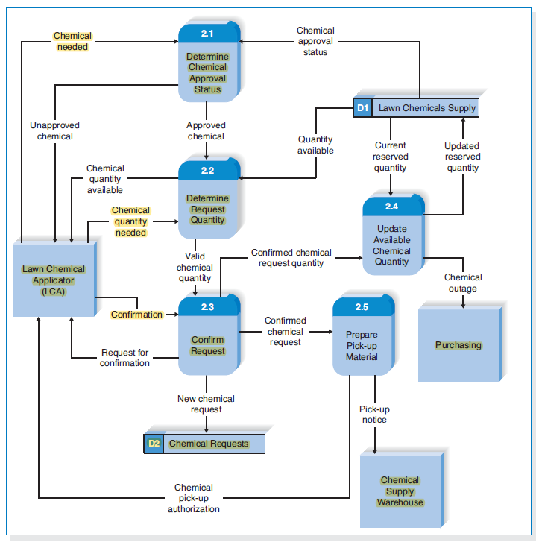
Analysis phase
Who will use it?
What should the system do for us?
Where & when will it be used?
Data Flow Diagrams

Slide 24
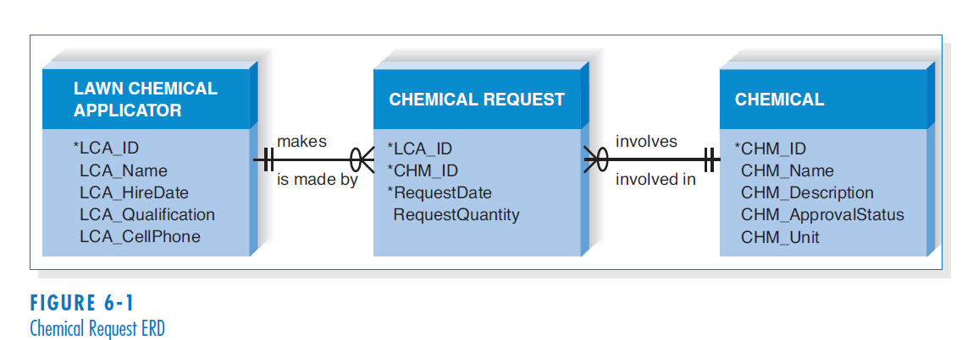
Analysis phase
Who will use it?
What should the system do for us?
Where & when will it be used?
ENTITY RELATIONSHIP DIAGRAM

Slide 25
SDLC: The Planning Phase
Project Initiation
Develop/receive a system request
Conduct a feasibility analysis
Project Management
Develop the work plan
Staff the project
Monitor & control the project

Slide 26
SDLC: The Analysis Phase
Develop an analysis strategy
Model the current system
Formulate the new system
Gather the requirements
Develop a system concept
Create a business model to represent:
Business data
Business processes
Develop a system proposal

Slide 27
SDLC: The Design Phase
Develop a design strategy
Design architecture and interfaces
Develop databases and file specifications
Develop the program design to specify:
What programs to write
What each program will do

Slide 28
SDLC: The Implementation Phase
Construct the system
Build it (write the programming code)
Test it
Install system
Train the users
Support the system (maintenance)

Slide 29
SDLC: Methodologies
Methodology: a formalized approach to implementing the SDLC
Categories
Process oriented
Data centered
Object-oriented
Structured
Rapid action development
Agile development

Slide 30
Classes of Methodologies
Structured Development
Waterfall Development
Parallel Development
Rapid Application Development
Phased
Prototyping
Agile Development
eXtreme Programming
SCRUM

Slide 31
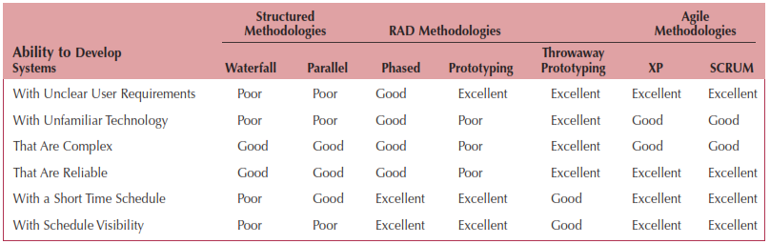
Which Methodology to Use?

Slide 32
The Systems Analyst: Skills
Agents of change
Identify ways to improve the organization
Motivate & train others
Skills needed:
Technical: must understand the technology
Business: must know the business processes
Analytical: must be able to solve problems
Communications: technical & non-technical audiences
Interpersonal: leadership & management
Ethics: deal fairly and protect confidential information

Slide 33
The Systems Analyst: Roles
Business Analyst
Focuses on the business issues
Systems Analyst
Focuses on the IS issues
Infrastructure Analyst
Focuses on the technical issues
Change Management Analyst
Focuses on the people and management issues
Project Manager
Ensures that the project is completed on time and within budget

Slide 34
Object-Oriented Systems Analysis & Design
Attempts to balance data and process
Utilizes the Unified Modeling Language (UML) and the Unified Process
Characteristics of OOAD:
Use-case Driven
Architecture Centric
Iterative and Incremental

Slide 35
Characteristics of Object-Oriented Systems
Classes & Objects
Object (instance): instantiation of a class
Attributes: information that describes the class
State: describes its values and relationships at a point in time
Methods & Messages
Methods: the behavior of a class
Messages: information sent to an object to trigger a method (procedure call)

Slide 36
Characteristics of Object-Oriented Systems (cont.)
Encapsulation & information hiding
Encapsulation: combination of process & data
Information hiding: functionality is hidden
Inheritance
General classes are created (superclasses)
Subclasses can inherit data and methods from a superclass

Slide 37
Characteristics of Object-Oriented Systems (cont.)
Polymorphism & dynamic binding
Polymorphism: the same message can have different meanings
Dynamic binding: type of object is not determined until run-time
Contrast with static binding

Slide 38
Object-Oriented Systems Analysis & Design
Use-case driven
Use-cases define the behavior of a system
Each use-case focuses on one business process
Architecture centric
Functional (external) view: focuses on the user’s perspective
Static (structural) view: focuses on attributes, methods, classes & relationships
Dynamic (behavioral) view: focuses on messages between classes and resulting behaviors

Slide 39
Object-Oriented Systems Analysis & Design (cont.)
Iterative & incremental
Undergoes continuous testing & refinement
The analyst understands the system better over time
Benefits of OOSAD
Break a complex system into smaller, more manageable modules
Work on modules individually

Slide 40
The Unified Process
A specific methodology that maps out when and how to use the various UML techniques for object-oriented analysis and design
A two-dimensional process consisting of phases and workflows
Phases are time periods in development
Workflows are the tasks that occur in each phase
Activities in both phases & workflows will overlap

Slide 41
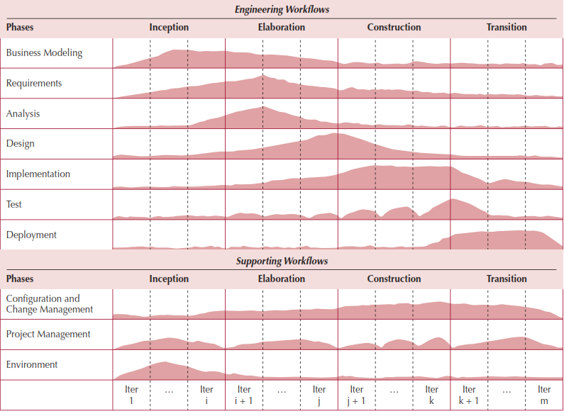
The Unified Process

Slide 42
Unified Process Phases
Inception
Feasibility analyses performed
Workflows vary but focus is on business modeling & requirements gathering
Elaboration
Heavy focus on analysis & design
Other workflows may be included
Construction: Focus on programming (implementation)
Transition--Focus on testing & deployment

Slide 43
Engineering Workflows
Business modeling
Requirements
Analysis
Design
Implementation
Testing
Deployment

Slide 44
Supporting Workflows
Project management
Configuration and change management
Environment
Operations and support*
Infrastructure management*
* Part of the enhanced unified process

Slide 45
Extensions to the Unified Process
The Unified Process does not include:
Staffing
Budgeting
Contract management
Maintenance
Operations
Support
Cross- or inter-project issues

Slide 46
Extensions to the Unified Process (cont.)
Add a Production Phase to address issues after the product has been deployed
New Workflows:
Operations & Support
Infrastructure management
Modifications to existing workflows:
Test workflow
Deployment workflow
Environment workflow
Project Management workflow
Configuration & change management workflow

Slide 47
Unified Modeling Language
Provides a common vocabulary of object-oriented terms and diagramming techniques rich enough to model any systems development project from analysis through implementation
Version 2.5 has 15 diagrams in 2 major groups:
Structure diagrams
Behavior diagrams

Slide 48
UML Structure Diagrams
Represent the data and static relationships in an information system
Class
Object
Package
Deployment
Component
Composite structure

Slide 49
UML Behavior Diagrams
Depict the dynamic relationships among the instances or objects that represent the business information system
Activity
Sequence
Communication
Interaction overview
Timing
Behavior state machine
Protocol state machine,
Use-case diagrams

Slide 50
Summary
All systems development projects follow essentially the same process, called the system development life cycle (SDLC)
System development methodologies are formalized approaches to implementing SDLCs
The systems analyst needs a variety of skills and plays a number of different roles
Object-oriented systems differ from traditional systems

Slide 51
Summary (cont’d)
Object-Oriented Systems Analysis and Design (OOSAD) uses a use-case-driven, architecture-centric, iterative, and incremental information systems development approach
The Unified Process is a two-dimensional systems development process described with a set of phases and workflows
The Unified Modeling Language, or UML, is a standard set of diagramming techniques

Slide 52
References
Denis, Wixom,Tegarden. (2015). Systems Analysis and Design: An Object-Oriented Approach with UML. 5th edition. ISBN: 978-1-118-80467-4, John Wiley & Sons, Inc, Denver (USA)

Slide 53
Some important notes in developing presentation file for online resources:
Important Notes
Please complete each presentation files with Learning Objectives information.
Please make sure to make Acknowledgement slide if you are using PowerPoint slides from textbook or the content of the slides are mainly adopted from the textbook.
If you are adding picture or information from other sources, please give reference footnote on the slide.
URL of the reference must be written in complete format, e.g. http://www.cocktailsoftheworld.com/uploads/pics/Jtho.jpeg
References slide must contain all references that have been used in the slides.

